Slide 1
Scrum Overview
Process
Results

Slide 2
Aganda
Agile Process
Why Agile
Traditional Waterfall Vs. Agile
Agile Manifesto
Agile – Scrum Framework
Scrum Characteristics & Values
Scrum Execution Model
Scrum Framework
Roles
Product Owner, Scrum Master, Team
Ceremonies
Sprint Planning
Sprint Review
Sprint Retrospect
Artifacts
Product Backlog
Sprint Backlog, Sprint Backlog – Burn down chart
User Stories
Estimation Methodologies
Scrum Smells
Environment & Build Deployment
Scalability & Scrum of Scrums
Agile Test Approach

Slide 3


Agile Process
Agile software development is a group of software development methodologies based on iterative and incremental development
Requirements and solutions evolve through collaboration between self-organizing, cross-functional teams.
It promotes adaptive planning, evolutionary development and delivery; time boxed iterative approach and encourages rapid and flexible response to change.
It is a conceptual framework that promotes foreseen interactions throughout the development cycle
Requirements
Design
Code
Test
Rather than doing all of one thing at a time...
...Agile do a little of everything all the time

Slide 4
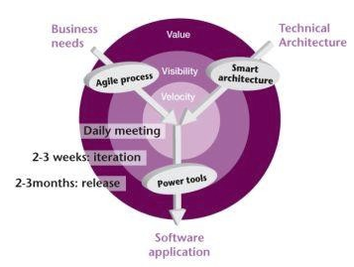
Why Agile
Accelerate Time to Market
Early and Continuous Customer Validation
Greater Visibility into Project Progress
Early Defect Detection and Prevention
Risk Reduction and Quality Improvement
Improve Team Morale

Slide 5
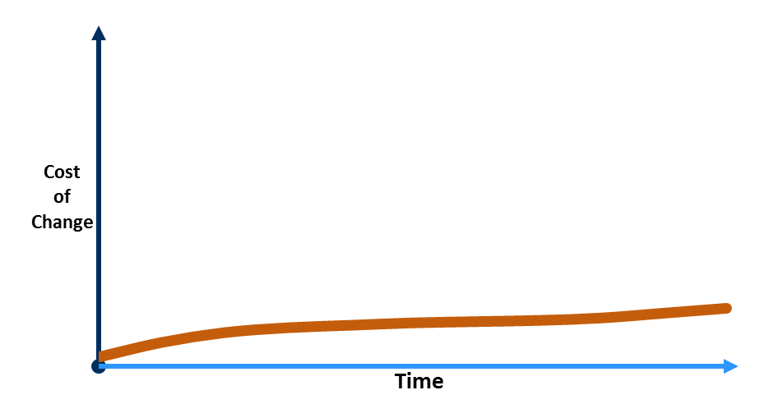
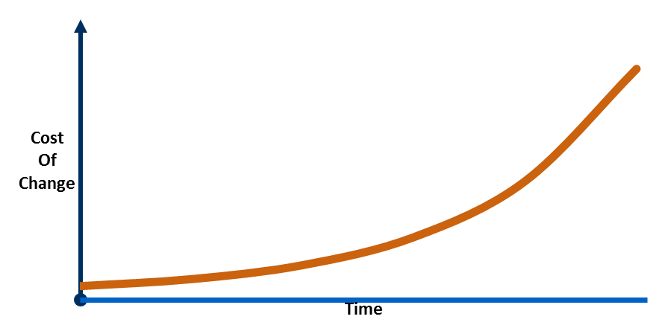
Traditional vs. Agile
Traditional: independent functional groups
Requirements
Business Requirements
Technical Requirements
Analysis & Design
System Specifications
Component Specifications
Code
C#, C, C++ etc.
Test
Deploy
Big-Bang Integration
Validation Tests
Verification Tests
BAs
Tester
Dev
Agile: works as one team
Iteration 1
Requirements
Analysis & Design
Code
Test
Requirements
Analysis & Design
Code
Test
Deploy
Iteration 2
Requirements
Analysis & Design
Code
Test
Iteration 3
Requirements
Analysis & Design
Code
Test
Iteration 4
Domain
Expert
Programmer
Tester

Slide 6






The Agile Manifesto–a statement of values
Individuals & Interactions
Working Software
Processes & Tools
Comprehensive Documentation
Customer Collaboration
Responding to Change
Contract Negotiation
Following a Plan

Slide 7
Agile – Scum Frame Work
Scrum is an agile process that allows us to focus on delivering the highest business value in the shortest time.
It allows us to rapidly and repeatedly inspect actual working software (every two weeks to one month).
The business sets the priorities. Teams self-organize to determine the best way to deliver the highest priority features.
Every two weeks to a month anyone can see real working software and decide to release it as is or continue to enhance it for another sprint.

Slide 8
Scrum Characteristics & Values
Characteristics
Self-organizing teams
Product progresses in a series of month-long “sprints”
Requirements are captured as items in a list of “product backlog”
No specific engineering practices prescribed
Uses generative rules to create an agile environment for delivering projects
Values:
Openness – sharing ideas between the
Focus – Task Oriented
Commitment – Adhere to task completions
Courage – Open to discuss on the impediments and solutions
Respect - Opinions
Visibility – What and how

Slide 9
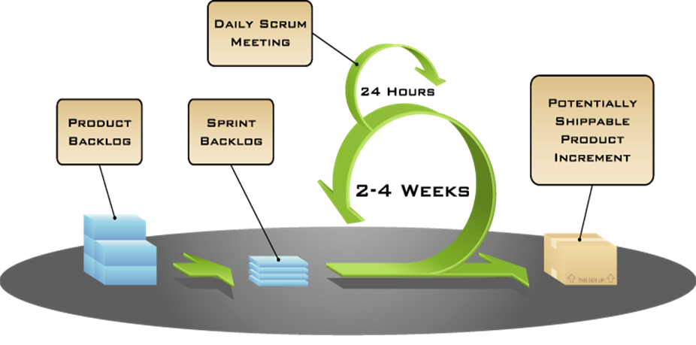
Scrum Execution Model

Slide 10
We’re losing the relay race
“The… ‘relay race’ approach to product development…may conflict with the goals of maximum speed and flexibility. Instead a holistic or ‘rugby’ approach—where a team tries to go the distance as a unit, passing the ball back and forth—may better serve today’s competitive requirements.”
Hirotaka Takeuchi and Ikujiro Nonaka, “The New New Product Development Game”, Harvard Business Review, January 1986.

Slide 11
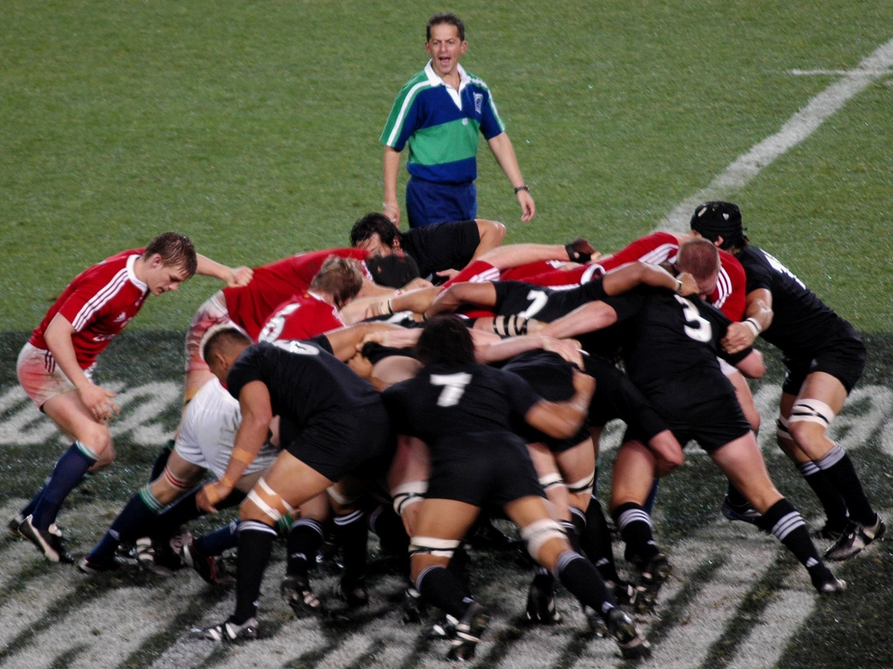
INTRODUCTION TO SCRUM

Slide 12
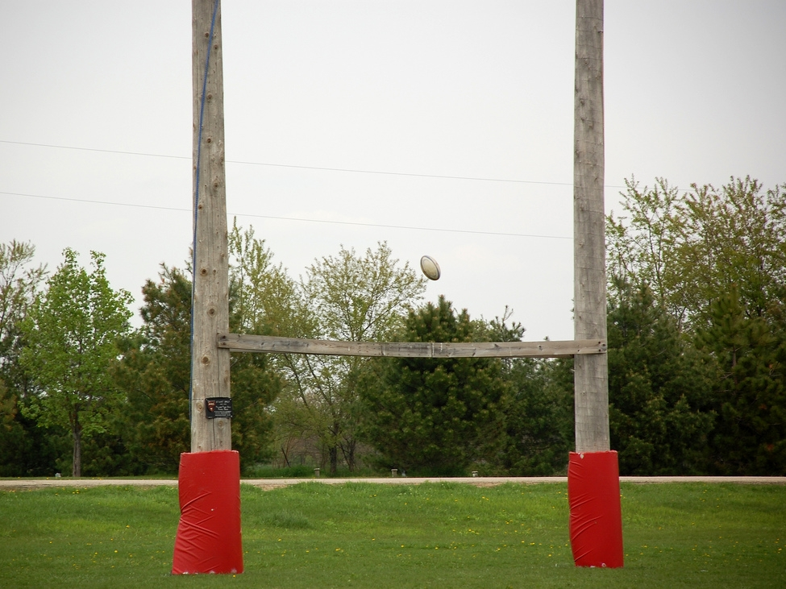
The Goal of Scrum
Manage Complexity, Unpredictability and Change
through Visibility, Inspection and Adaptation

Slide 13
Scrum has been used by:
Microsoft
Yahoo
Google
Electronic Arts
High Moon Studios
Lockheed Martin
Philips
Siemens
Nokia
Capital One
BBC
Intuit
TCS
Infosys
Intuit
Nielsen Media
First American Real Estate
BMC Software
Ipswitch
John Deere
Lexis Nexis
Sabre
Salesforce.com
Time Warner
Turner Broadcasting
Oce
L&T India

Slide 14
Scrum framework
Roles
Product owner
ScrumMaster
Team
Ceremonies
Sprint planning
Sprint review
Sprint retrospective
Daily scrum meeting
Artifacts
Product backlog
Sprint backlog
Burndown charts

Slide 15
Scrum framework
Roles
Product owner
ScrumMaster
Team
Ceremonies
Sprint planning
Sprint review
Sprint retrospective
Daily scrum meeting
Artifacts
Product backlog
Sprint backlog
Burndown charts

Slide 16


Product Owner (Product Champion)
Owner of project vision represents the customer
Owner of the prioritized product backlog
Represents users & stakeholders when talking to team
Represents team when talking to users & stakeholders
Be responsible for the profitability of the product (ROI)
Is a combo of Product Manager and BA
Ultimately responsible for entire product hence the single
Wringable neck
Users/stakeholders:
Those that are going to use the product or have a vested interest in how it turns out.
Team:
Team that will create the product, includes EVERYONE that is part of product creation

Slide 17

Scrum Master(Agile Project Manager)
Responsible for meetings and enacting Scrum values and practices
Removes impediments
Ensure that the team is fully functional and productive
Enable close cooperation across all roles and functions
Shield the team from external interferences
Can act as a process coach and help team improve the process
Servant Leader

Slide 18





The Team
Typically 5-9 people
Cross-functional:
Programmers, testers, user experience designers, etc.
Members should be full-time
May be exceptions (e.g., database administrator)
Teams are self-organizing
Ideally, no titles but rarely a possibility
Membership should change only between sprints

Slide 19
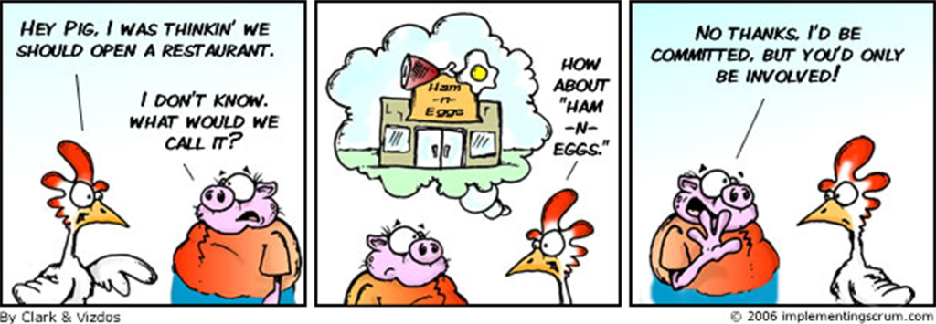
Pigs and Chickens
Pigs and Chickens
Product Owner
Scrum Master
Team Members
Users
Marketing
Managers

Slide 20
Scrum framework
Roles
Product owner
ScrumMaster
Team
Ceremonies
Sprint planning
Sprint review
Sprint retrospective
Daily scrum meeting
Artifacts
Product backlog
Sprint backlog
Burndown charts

Slide 21


Sprint
Scrum projects make progress in a series of “sprints”. An iteration of work during which an increment of product functionality is implemented.
Product is designed, coded, and tested during the sprint
Typical duration is 2–4 weeks or a calendar month at most
The sprint starts with sprint planning. Many daily Scrum meetings occur during the sprint (one per day). At the end of the sprint we have a sprint review meeting, followed by a sprint retrospective meeting.
During the sprint, the team must not be interrupted with additional requests. Guaranteeing the team won't be interrupted allows it to make real commitments it can be expected to keep.
Sprint
2-4 weeks

Slide 22
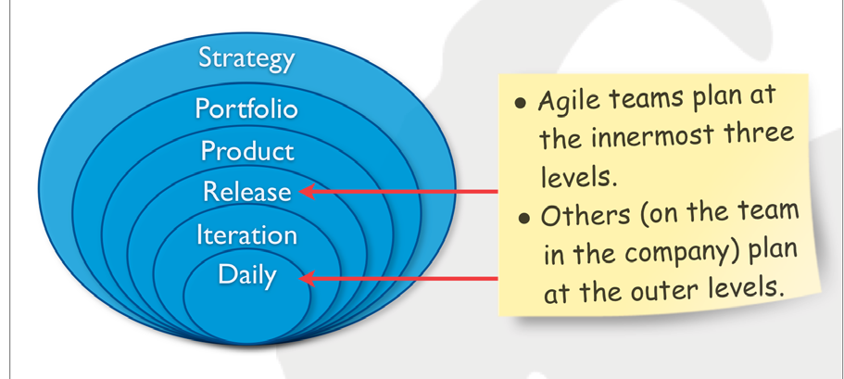
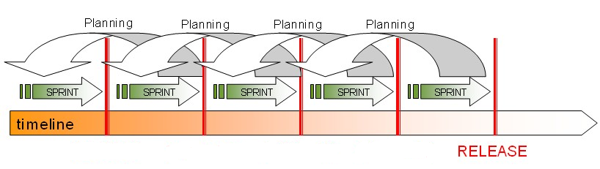
Release Planning
Product Release Planning consists multiple Sprints
Multi Level Planning needed
Product Vision
Roadmap
Release Planning
Sprint Planning
Daily Planning

Slide 23


Sprint Planning
Team capacity
Sprint planning meeting
Sprint prioritization
Product backlog
Sprint
goal
Analyze and evaluate product backlog
Select sprint goal
Business conditions
Sprint planning
Decide how to achieve sprint goal (design)
Create sprint backlog (tasks) from product backlog items (user stories / features)
Estimate sprint backlog in hours
Current product
Sprint
backlog
Technology

Slide 24

Estimation Vs Sizing
Sizing: No. representing how big an item is w.r.t. other items rather than how long it will take to complete
Estimate: No. representing how long it will take to complete
Estimate | Size
Measured as a Unit of Time | No Units associated with it
Rarely > 75% accuracy | Usually accurate to within the measurement used
Difficult to create | Can be created quickly
Not related to other things being estimated | Always relative to previously created sizes
Generally represents an immediate commitment | Cannot represent a time commitment without further refinement (not time units!)
Artiacts

Slide 25
Planning Poker for Estimation
Its An iterative approach for estimation
Why Poker card Planning:
Team members are going to do, they only estimate the work
Estimators are required to justify the estimates.
How to Estimate:
1. Each estimator is given a deck of cards, each card has a valid estimate written on it
2. Product owner/Scrum master reads a story and it’s discussed briefly
3. Each estimator selects a card that’s his or her estimate
4. Cards are turned over so all can see them
5. Discuss differences (especially outliers)
6. Re-estimate until estimates converge
Advantages:
Combining the individual estimates and discuss briefly
Everyone’s opinion is heard, Final estimation will be agreed by all

Slide 26
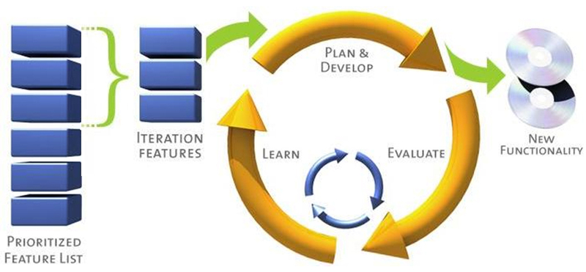
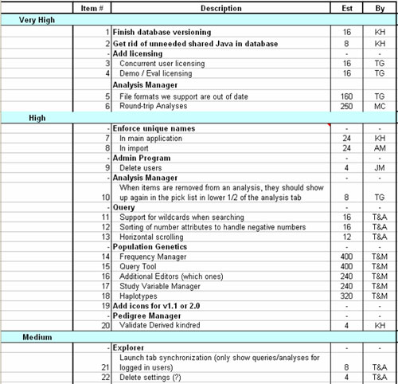
Product Backlog
The Product Backlog is the master list of all functionality desired in the product
Product Log contains the features to be delivered during the release
All the features must be denoted with User Stories
All the features must be prioritized and pulled to the sprints by the team
High
Medium
Low
Product owner is the responsible person for all features delivered in the release

Slide 27
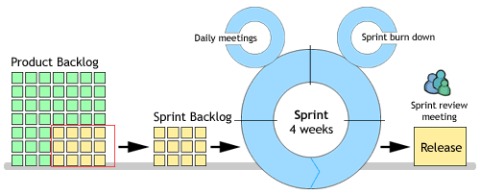
Sprint Backlog
The sprint backlog is the list of tasks that the Scrum team is committing that they will complete in the current sprint.
Items on the sprint backlog are drawn from the Product Backlog, by the team based on the priorities set by the Product Owner
Sprint Goal will be determined by the team and Scrum Master should drive it.
Scrum Master maintains the Sprint Backlog and owns its completion
Sprint Backlog will maintain below
User Stories
Tasks
Burn down Charts

Slide 28
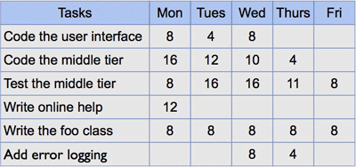
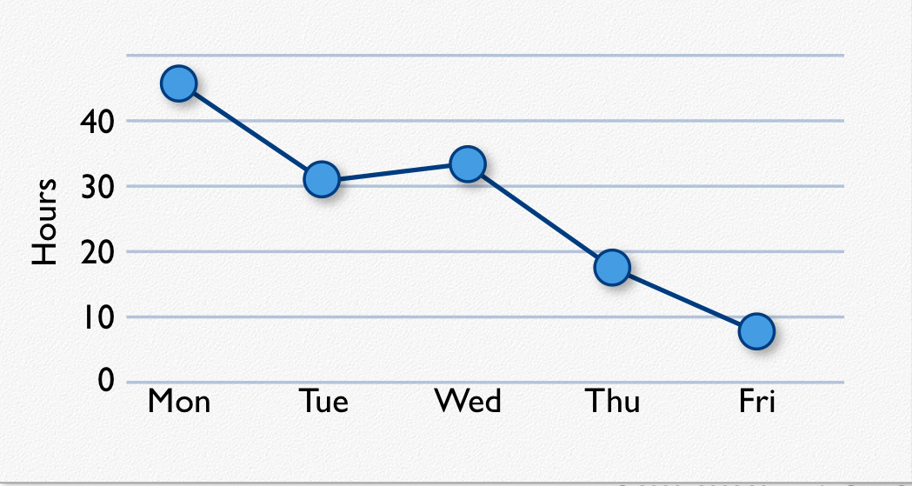
Sprint Backlog – Burn down chart
Individuals sign up for work of their own choosing
Estimated work remaining is updated daily
Any team member can add, delete or change the sprint backlog
Work for the sprint emerges
If work is unclear, define a sprint backlog item with a larger amount of time and break it down later
Update work remaining as more becomes known

Slide 29

User Stories
List of requirement will be specifies in an organized way i.e User Stories
User Stories are the functionalities to be delivered in the Scrum.
Functionalities will be specified User perceptive
Ideal User Story format will be like
As a User <Role> I want < Condition> So that, I can achieve < desired goal>
Objectives of User Stories
Card: Stories are written on note cards and will be divided as tasks
Confirmation: Acceptance test will be conducted Story developed properly

Slide 30
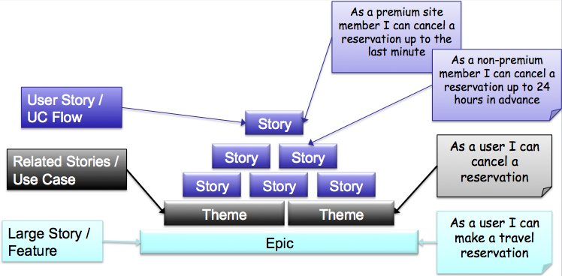
More about User Stories
Better understanding of what is really valuable for the user
More flexibility with Planning Prioritizing, and cutting scope
More Knowledge about what to build
A Good Story
Independent
Negotiable
Valuable
Estimatable
Small
Testable

Slide 31

Sprint Planning
Team selects items from the product backlog they can commit to completing
Sprint backlog is created
Tasks are identified and each is estimated (1-16 hours)
Collaboratively, not done alone by the Scrum Master
High-level design is considered
Code the middle tier (8 hours)
Code the user interface (4)
Write test fixtures (4)
Code the foo class (6)
Update performance tests (4)
As a vacation planner, I want to see photos of the hotels.

Slide 32




Daily Scrum
1
What did you do yesterday?
Parameters
Daily
15-minutes
Stand-up
Not for problem solving
Only team members, Scrum Master, product owner, can talk
Helps avoid other talks
Every one Answers 3 questions
These are not status for the Scrum Master
They are commitments in front of peers
2
What will you do today?
3
Is anything in your way
(Impediments)?

Slide 33
How does Velocity Help us?
Velocity is the amount of work a team can accomplish in a given time period
If we are consistent in our estimates, then velocity will be consistent as well
If we keep trying to get more accurate and become less consistent, then we don’t have a consistent velocity
If we have sizes, we can derive duration once we know velocity
Total Size/Velocity = Duration
50 points/20 points velocity = 2.5 time periods

Slide 34
Velocity Fundamentals
How is velocity calculated?
Velocity is the sum of the estimates of delivered (i.e., accepted) features per iteration.Unit used to measure velocity is
Story points, days, ideal days, or hours - all of which are considered acceptable.
How is the first iteration's velocity estimated?
Plan initial velocity = 1/3rd of available time in order to account for meetings, email,documentation, rework, collaboration,etc. eg. With 6 programmers and 2-week iterations, a total of 60 programmer-days are available. In this situation, a good start would be to plan 20 ideal days worth of work in the iteration.
Do meetings, phone calls, email get included in velocity?
This depends on whether these items are estimated and included in the iteration plans. They are typically not included - a goal of velocity is relative consistency and predictability across iterations in terms of a team's ability to deliver.
What if velocity fluctuates?
Wthin a reasonable range, is perfectly fine. If velocity fluctuates widely for more than 1 or 2 iterations, the team may need to re-estimate and/or renegotiate the release plan.
How long does it take for velocity to stabilize?
Team velocity will typically stabilize between 3 and 6 iterations

Slide 35
Velocity Fundamentals
How do I estimate velocity if project teams change size?
Velocity relies on team consistency in order to be most valuable. If a team changes, use common sense in planning future iterations. If 20% of your team is unavailable for a couple iterations, then reduce planned velocity by 20% or so. If this includes a couple of key players, in particular a customer that may be less available, then reduce the estimate a little more. It will only take the length of the next iteration to understand better what the team can deliver and thus their new velocity.
Does maximum velocity mean maximum productivity?
Absolutely not. In an attempt to maximize velocity, a team may in fact achieve the opposite. If asked to maximize velocity, a team may skimp on unit or acceptance testing, reduce customer collaboration, skip fixing bugs, minimize refactoring, or many other key benefits of the various Agile development practices. While potentially offering short-term improvement (if you can call it that), there will be a negative long-term impact. The goal is not maximized velocity, but rather optimal velocity over time, which takes into account many factors including the quality of the end product.
How do we measure velocity if our iteration lengths change?
You don't, at least not nearly as easily. Velocity's value comes from its inherent consistency. A fixed iteration length helps drive the reliable rhythm of a project. Without this rhythm, you are constant revising, re-estimating, and reconciling, and the ability to predict out in the future is minimized due to inconsistent results. If, on the other hand, almost everyone is going to be out a week for the holidays or a couple days for company-wide meetings, then by all means simply use common sense and adapt iteration dates or velocity accordingly. Like most Agile

Slide 36
How can we know if we can commit
For each story in an iteration the team will:
Ask any clarifying questions
Break the work to complete the story into tasks using a very simple scale
0.5,1,1.5 or 2 days are the allowable task durations
The task list must be everything required to make the story be “done”
For each story a number representing task days per size point is calculated
Eg. If a story is a size 3 and the task estimates add to 4 days, the number calculated would be 4/3 or 1.33
After all stories have the number calculated, any story with a number that is not near the average is re-examined
Does the story need to be re-sized?(do it)
Did we forget some tasks?(add them)
Is it just rounding error and it is ok?

Slide 37
Agile Software Requirements Management
Changing Requirements Are a Competitive Advantage if You Can Act on them: www.agilemodeling.com/essays/changeManagement.htm

Slide 38
No changes during a sprint
Change
Plan sprint durations around how long you can commit to keeping change out of the sprint

Slide 39

Start / Stop / Continue
Whole team gathers and discusses what they’d like to:
Start doing
Stop doing
This is just one of many ways to do a sprint retrospective.
Continue doing

Slide 40

Sprint Termination
Only in extreme cases
Team terminates: cannot meet sprint goal
Product Owner terminates: priority change
Work reverted to end of prior sprint
Raises visibility of problems

Slide 41
Scrum framework
Roles
Product owner
Scrum Master
Team
Ceremonies
Sprint planning
Sprint review
Sprint retrospective
Daily scrum meeting
Artifacts
Product backlog
Sprint backlog
Burndown charts

Slide 42

Product backlog
High-level requirements Not complete, nor perfect
Expressed as business value
Prioritized by the product owner
Reprioritized at the start of each sprint
Expected to change & evolve
This is the product backlog

Slide 43
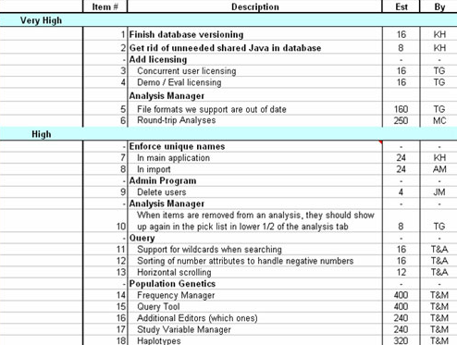
Product backlog
Includes rough
estimates
Prioritized by
value & risk
Publicly
visible
Better to describe
as user stories

Slide 44
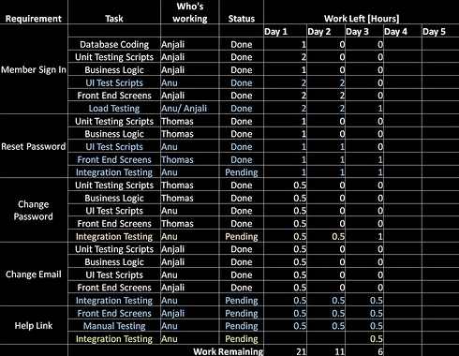
Iteration/Sprint Backlog
sample

Slide 45
Sprint Backlog
Owned by the team
Team allocates work
No additions by others

Slide 46
A sprint backlog
Tasks
Mon
Tues
Wed
Thur
Fri
Code the user interface
8
4
8
Code the middle tier
16
12
10
4
Test the middle tier
8
16
16
11
8
Write online help
12
Write the foo class
8
8
8
8
8
Add error logging
8
4

Slide 47
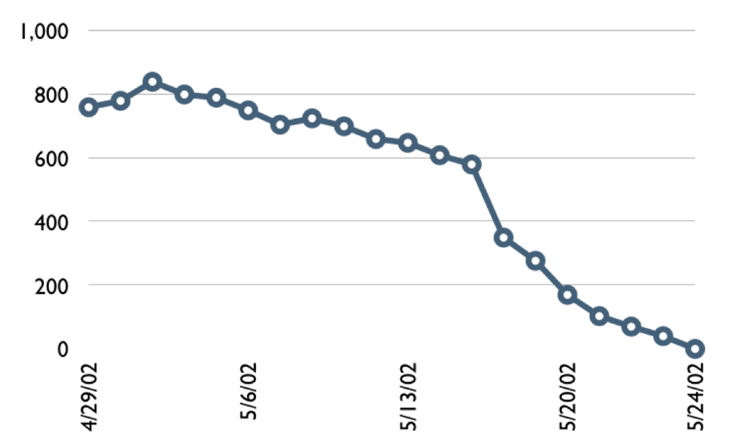
A sprint burndown chart

Slide 48
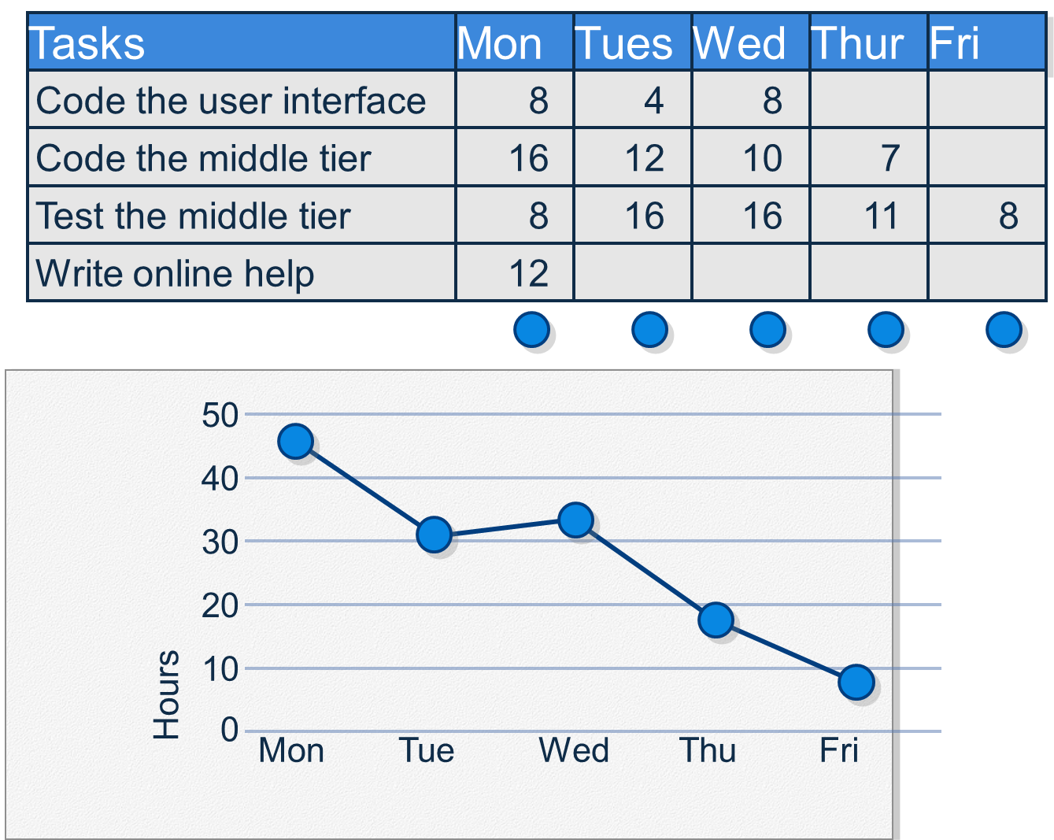

Slide 49
Effectiveness of Requirements Gathering Techniques

Slide 50
Relative Effectiveness of User Representatives

Slide 51
Communication Modes Always Strive to Use the Most Effective Approach

Slide 52






Scalability & Scrum of Scrums
Typical individual team is 7 ± 2 people
Scalability comes from teams of teams
Factors in scaling
Type of application
Team size
Team dispersion
Project duration
Scrum has been used on multiple 500+ person projects also

Slide 53
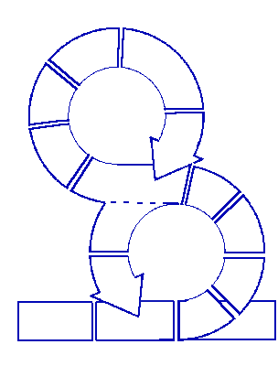
Large Project, Multiple Teams
Daily Scrums
per Sprint
Sprint 1
9:00AM 9:15AM
9:15AM 9:30AM
Sprint 2
9:30AM 9:45AM
Sprint 3
9:45AM 10:00AM

Slide 54
Scrum of Scrums

Slide 55
Scrum of scrums of scrums

Slide 56
Scrum smells
Loss of Rhythm: Daily Scrum skipped/ meeting times vary, Sprint durations inconsistent
Talking Chickens : outsiders talking
Missing Pigs : members missing meetings
Failing in Backlog Management
Persistent Signatures
Scrum Master Assigns Work
The Daily Scrum is For the Scrum Master
Testers will not integrate with Team
Reluctance to estimate Backlog Items
Is It Really Done
Nothing Ever Changes Around Here
No One Wants to Attend Retrospectives
Missing Sprint Commitment
Technical Debt
Gorilla in the Room: One person (Sr Developer, Tech Lead,) dominates conversation. People won't speak until the Gorilla has spoken.

Slide 57
Environment & Build Deployment
Scrum Development required Multiple Environments
Development Environment
QA Environment
Automation Environment
Daily Build Deployment
Provides state of certainty
Test Automation Environment
Sanity Testing required through Test Automation

Slide 58
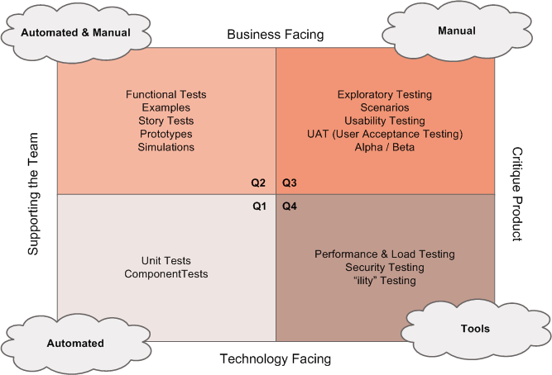
Agile Test Approach
Testers are first class citizens on agile teams and part of the “whole team” supporting customers, business stakeholders, developers and other team members
Testers support quality infusion through entire team and product cycle
Test tasks and stories are planned and executed like development tasks and stories
Automate where possible and use session-based testing for exploratory testing
Communicate through information radiators

Slide 59
Agile Testing Principles
Provide continuous feedback
Deliver value to the customer
Enable face-to-face communication
Have courage
Keep it simple
Practicese continuous improvement
Respond to change
Self-organize
Focus on people
Enjoy

Slide 60
Agile Testing Success Factors
Testers are part of the team
Agile testing mindset
Automate tests
Look at the big picture
Drop the “Quality Police” mindset
Automate tests wherever practical
Focus on team goals & customer value
Need rapid feedback
Balance against developer focus on technical implementation
Use agile test matrix as guide
Collective ownership
Foundation of critical practices
Collaborate
Continually improve
Collaborate with customers
Team retrospectives
Session-based testing, agile test environments
Informative workspace
Collaborate within team
Personal training: reading, blogs, QAI, local QA groups

